Slide 1
C Loops

Slide 2
while loop in C
Syntax
The syntax of a while loop in C programming language is:
while(condition)
{
statement(s);
}

Slide 3
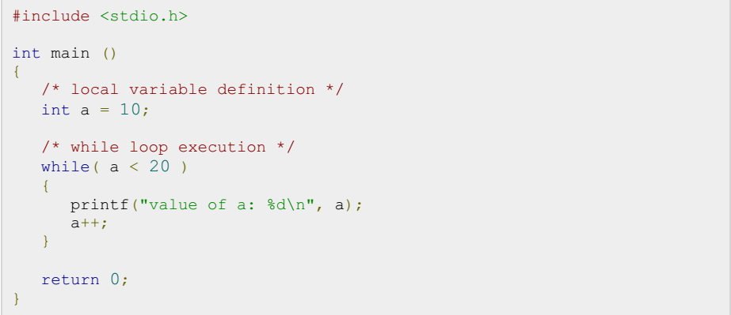
Example

Slide 4
for loop in C
Syntax
The syntax of a for loop in C programming language is:
for ( init; condition; increment )
{
statement(s);
}

Slide 5
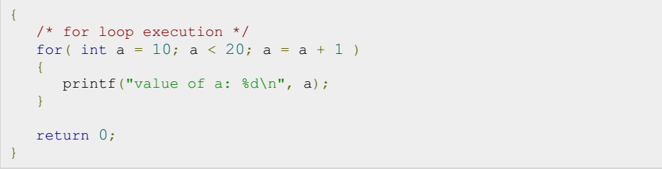
Example

Slide 6
do...while loop in C
Unlike for and while loops, which test the loop condition at the top of the loop, the do...while loop in C programming language checks its condition at the bottom of the loop.
A do...while loop is similar to a while loop, except that a do...while loop is guaranteed to execute at least one time.
Syntax
The syntax of a do...while loop in C programming language is:
do
{
statement(s);
} while( condition );

Slide 7
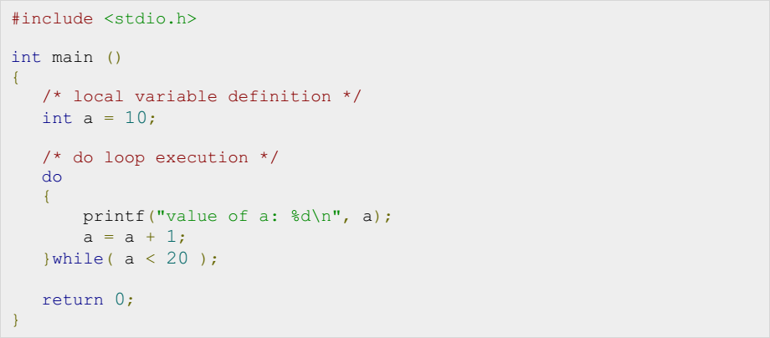
Example

Slide 8
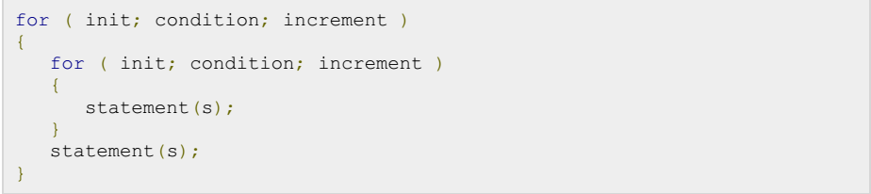
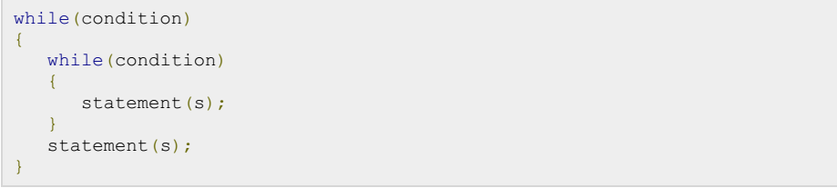
nested loops in C

Slide 9
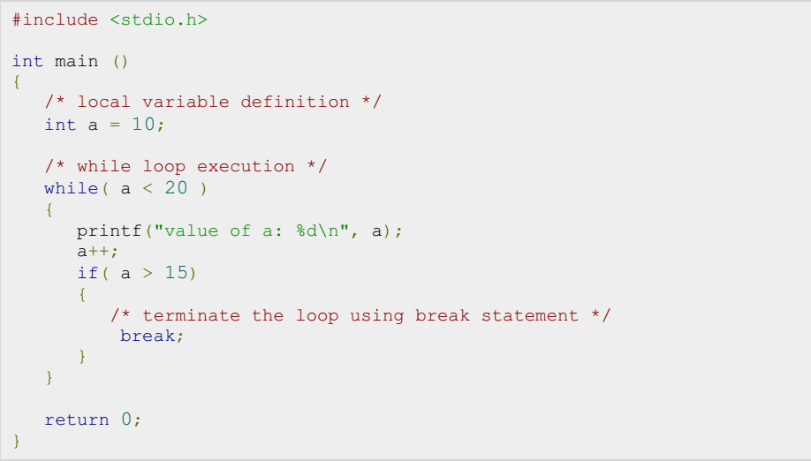
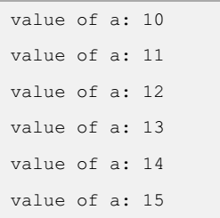
break statement in C
Notes:
When a break statement is encountered inside a loop, the loop is immediately terminated and the program control resumes at the next statement following the loop.

Slide 10
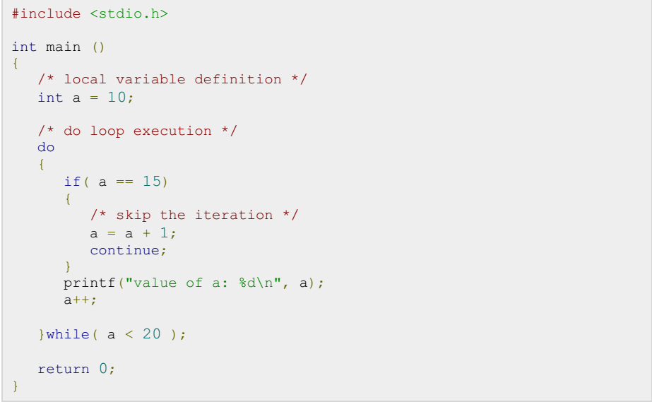
continue statement in C
The continue statement in C programming language works somewhat like the break statement. Instead of forcing termination, however, continue forces the next iteration of the loop to take place, skipping any code in between.

Slide 11
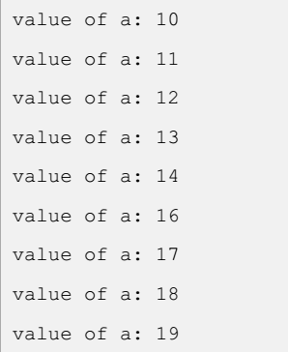
continue statement in C
Output:

Slide 12
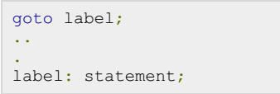
goto statement in C
A goto statement in C programming language provides an unconditional jump from the goto to a labeled statement in the same function.
Syntax

Slide 13
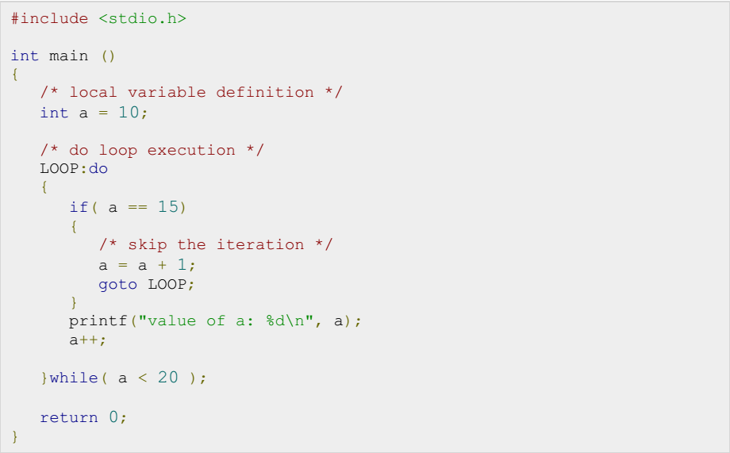
Example- goto statement

Slide 14
Example-goto statement
Output:

Slide 15
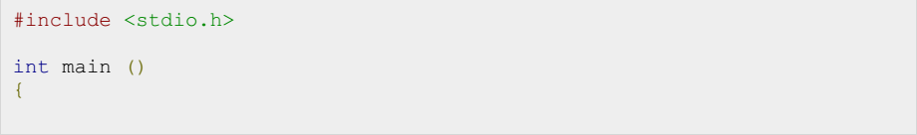
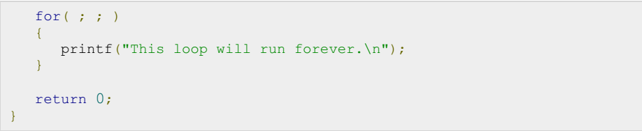
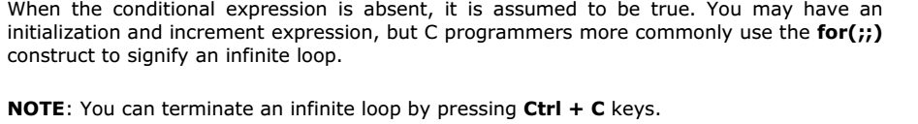
The Infinite Loop
A loop becomes infinite loop if a condition never becomes false.

